Slide 1
This material has been created and distributed for the purpose of education and to encourage best practices of the HVAC industry. The integrity of the industry we share is the responsibility of every one working in it, including its educators, to uphold the faith of the consumers who put their trust in us as professionals.
The text and images in this power point are not to be modified without express written permission of Genteq™. This power point as a whole may be used, but not sold, for educational purposes. This power point as a whole may be included in the bulk of other educational power point presentations.
Portions of this Power Point including text in the form of sentences and/or paragraphs as written, and/or images may be used in the bulk of educational material without modification. All material including images used for this purpose must be accompanied by or noted in the footer of the slide or slides the material appears in with “Courtesy of Genteq™” in Arial font as it appears here.
This slide is hidden. It will not show up during presentation.

Slide 2
What’s with all the copyright stuff?
Three main purposes of the copyrights:
Prevent the sale of as produced material we are creating and giving away to the HVAC educational community for individual profit. Including this information in your HVAC courseware is encouraged.
Prevent the information from being altered to be untrue, unsafe or out of the recommended best practices of the HVAC industry.
Simply be recognized for our hard work and efforts to provide quality information for the betterment of the HVAC industry.
This slide is hidden. It will not show up during presentation.

Slide 3

Electric Motors and Filtration

Slide 4
The ECM Textbook
Table of Contents
History of ECM
Motor Technologies
Static Pressure Impact
Notes:
This power point contains images that are not in the printed version. This was done to keep the size of the printed text short and improve the concepts that are being taught in the classroom.

Slide 5


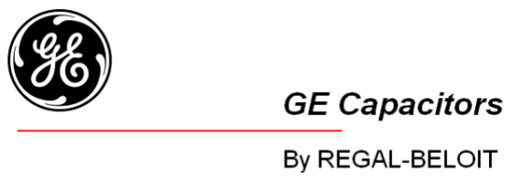
History of ECM Technology
1987
General Electric introduces first ECM to residential HVAC
2004
Regal Beloit purchases the ECM, PSC and Capacitor divisions from GE with permission to brand as:

Slide 6






Regal-Beloit Corporation Background
History of ECM Technology
Public Corporation established in 1955 -
History
50s to 70s - Special Cutting Tools
80s to 90s – Mechanical Power Transmission
90s to 00s – Motors and Generators
Largest Non-Captive Motor supplier globally
#1 Commercial and Industrial and #1 HVAC
Recognized Motor Brands
NYSE – RBC
Notes:
Define Non-Captive (part used by a manufacturer in a product that is not produced by the manufacturer)

Slide 7
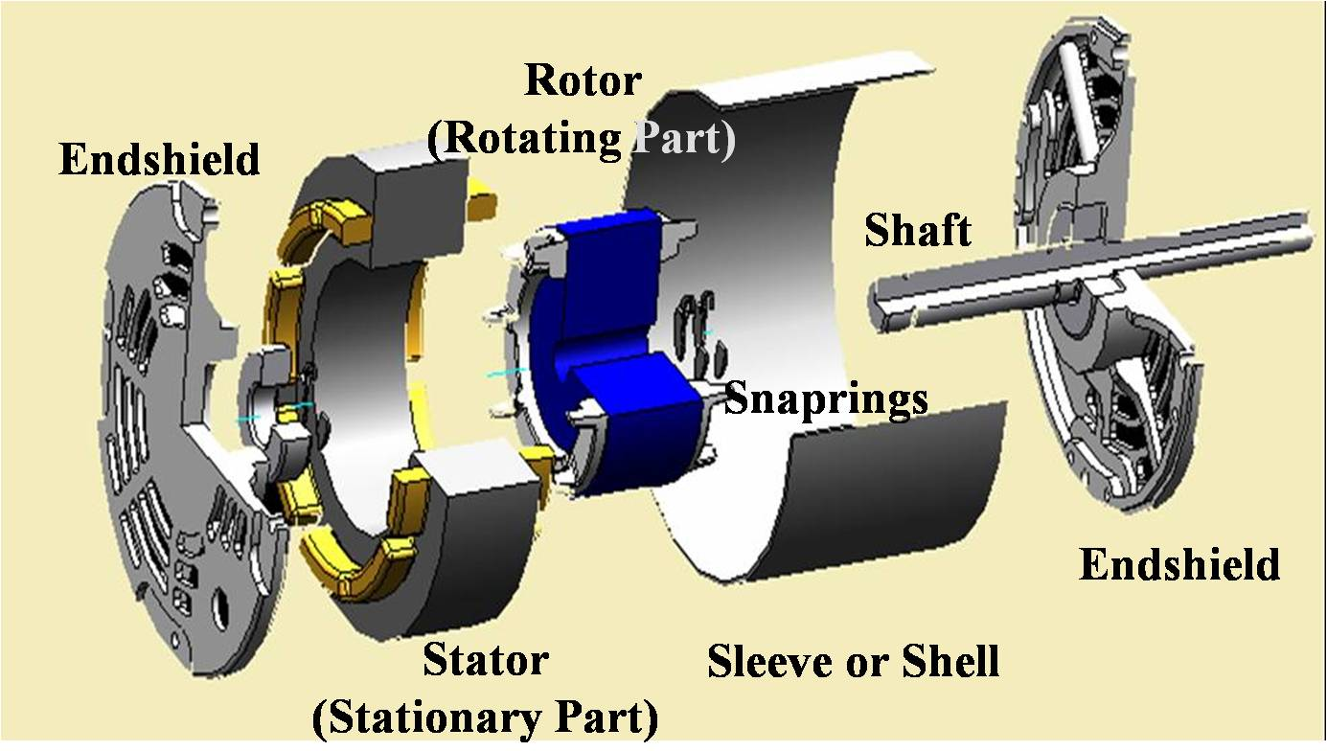
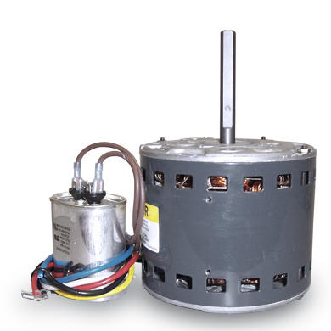
Permanent Split Capacitor
Mid 1900’s PSC replaces shaded pole as standard
Better starting torque and efficiency
Low cost and simple
Limited operation due to fixed motor poles, fixed supplied frequency (60 Hz), 3-5 speeds
Slave to airside resistance
PSC

Slide 8
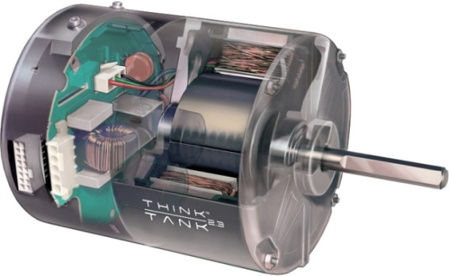
ECM Technology
ECM (Electronically Commutated Motor)
Brushless DC, permanent magnet rotor
More efficient than PSC motors
Used throughout HVACR
Programmable
Operated by a microprocessor based control
Ability to compensate for airside restrictions
ECM

Slide 9

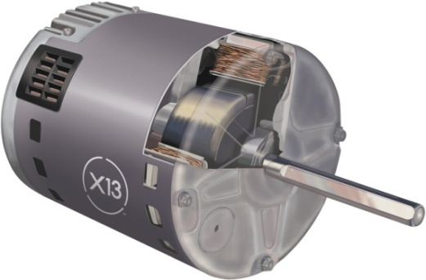
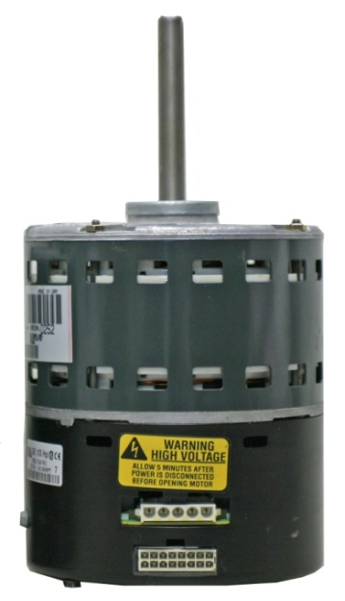
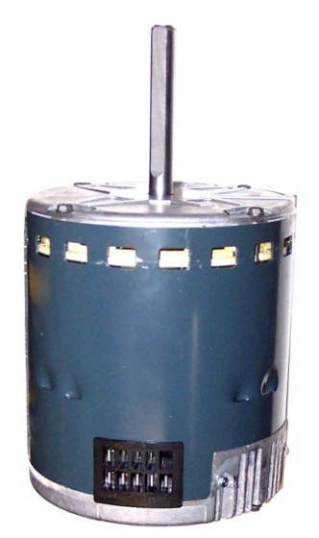
Overview of ECM Technology
Motor Control and Motor as separate components
Motor Control integrated into the motor shell
Motor
Motor
Motor Control
Motor Control

Slide 10
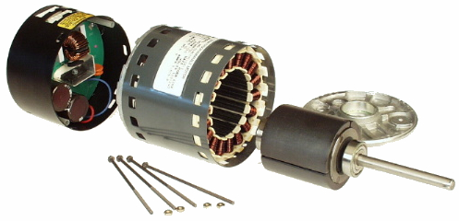
Overview of ECM Technology
The Motor Control
Connected to single phase (1Ø) 120, 240 or 460vac 50 or 60 cycle power (Hz)
AC power is converted to DC power to operate the electronics
DC power is converted to a three phase (3Ø) signal to drive motor
Microprocessor controls frequency (RPM) and torque (power) delivered to motor.
Motor
Motor
Control
Permanent magnet rotor

Slide 11
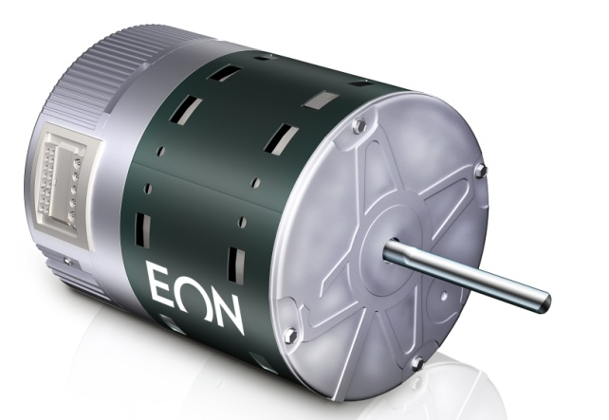
Constant Airflow ECM
Operation
Motor control monitors speed and torque delivered to the motor
Torque and speed can be increased or decreased to maintain airflow automatically
Increased external static pressure = more energy to maintain airflow and potentially increased system air noise
Decreased external static pressure = less energy to maintain airflow and decreased system air noise
Motor has a programmed limit due to energy (current) used to maintain airflow at high external static pressures
If system exceeds HVAC OEM recommended maximum total external static pressure, airflow may not be maintained
Motor will deliver as much air as possible without causing damage

Slide 12
Constant Airflow ECM
Definition
Constant Airflow
Maintained during changes in external static pressure
External Static Pressure (ESP) – resistance to air movement
Undersized, poorly constructed or dirty ductwork
Dirt build up on air distribution system components
Airflow is maintained in all situations within limits of HVAC OEM programming and design
PSC motors produce less airflow when ESP increases

Slide 13
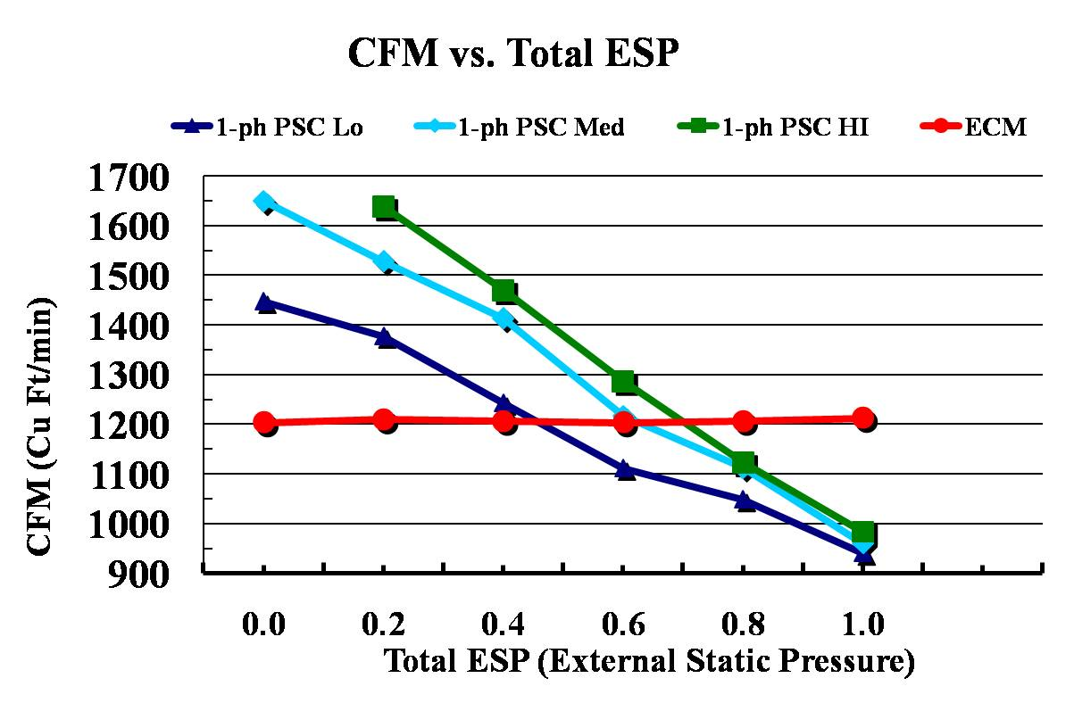
Constant Airflow ECM

Slide 14
Constant Airflow ECM
Benefits
When set up correctly benefits include:
Energy Savings
Improved outlet air temperature for each system demand
Improved humidity control
Improved system capacity
Reduced space temperature swings
Reduced air noise, soft start/stop, gradual airflow change between demands, delays and/or profiles
Reduced continuous fan air noise, increased energy savings
Reduced repairs associated with continuous low airflow operation

Slide 15
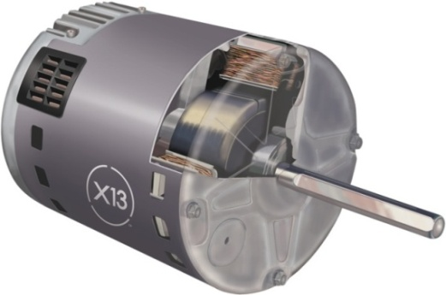
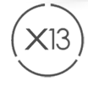
Constant Torque ECM
Constant Torque (OEM) Indoor Blower Motor
Genteq introduced the Constant Torque motor in 2006
Model X13
Indoor blower motor
Residential & Light Commercial HVAC split system and package systems 5 ton or less in size
Define the type and style of ECM programmed functions
New tier of ECM indoor motors

Slide 16

Constant Torque ECM
Application
Split system air handlers and package systems
Single or Two Stage
Benefit
Torque is maintained if external static pressure changes
Better airflow than PSC
Better system performance and efficiency than PSC
More precise airflow with programmed torque
HVAC OEM only programs the tap(s) needed
Energy savings of ECM with simplicity of PSC

Slide 17
Retrofit Motors - Evergreen

Slide 18
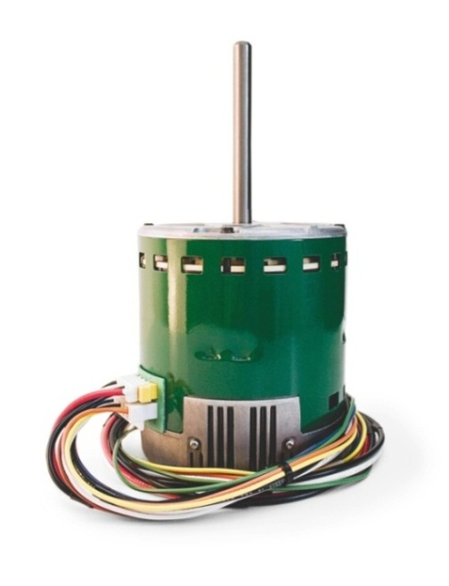

Constant Torque ECM
Constant Torque (Retrofit) Indoor Blower ECM
Genteq introduced the Evergreen motor in 2008
Indoor blower motor
PSC retrofit
ECM Technology in first aftermarket application
Energy Efficiency & Constant Torque with the simplicity of a PSC
Field proven in OEM X13 since 2006

Slide 19
Constant Torque ECM
Constant Torque (Retrofit) Indoor Blower ECM
Covers all Split and Package Systems
4 speeds (programmed levels of torque)
Constant Torque
Optimized constant fan speed
Multi-horse power, Rotation Sensing, Dual Voltage

Slide 20
Constant Torque ECM
Benefits
Upgrade existing HVAC Systems with PSC motors
Increase electrical efficiency
Optimized constant fan
Approximately 50% airflow
Quietly optimizes IAQ products and decreased stratification
Up to 75% fewer watts than PSC
Improve airflow when total ESP changes
Torque is maintained by speed (torque) selection
Constant torque is not constant airflow (variable speed)

Slide 21
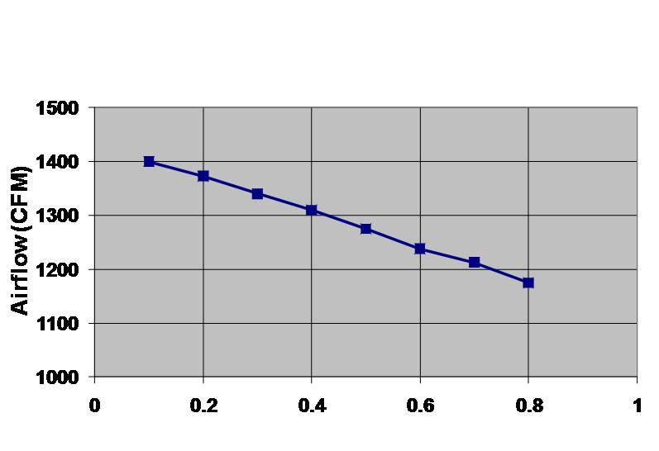
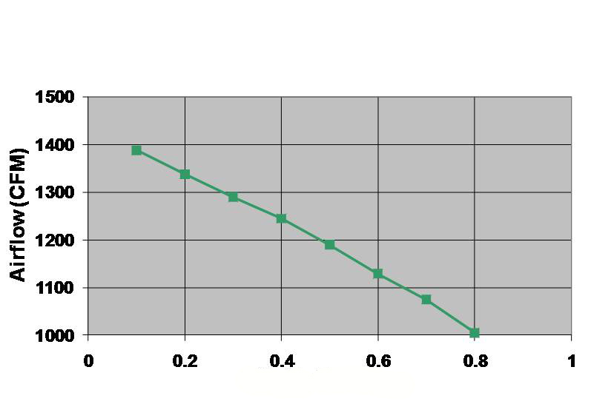
Constant Torque ECM
Evergreen Motor
PSC Motor
Total ESP (External Static Pressure)
Total ESP (External Static Pressure)

Slide 22
Motors and Static Pressure

Slide 23
How Has The Industry Changed?
Total External Static Pressure (TESP)
Ductwork
Poorly sized and constructed
Indoor Coil
Increased resistance with higher SEER
Air Filter
Poorly sized
Increased MERV ratings
Blower Performance
Permanent Split Capacitor (PSC)
Constant Torque ECM
Constant Airflow ECM

Slide 24
What’s The Problem?
Contractors lack basic airflow knowledge
Lets start with some fundamentals
Total External Static Pressure (TESP)
Blower Performance

Slide 25
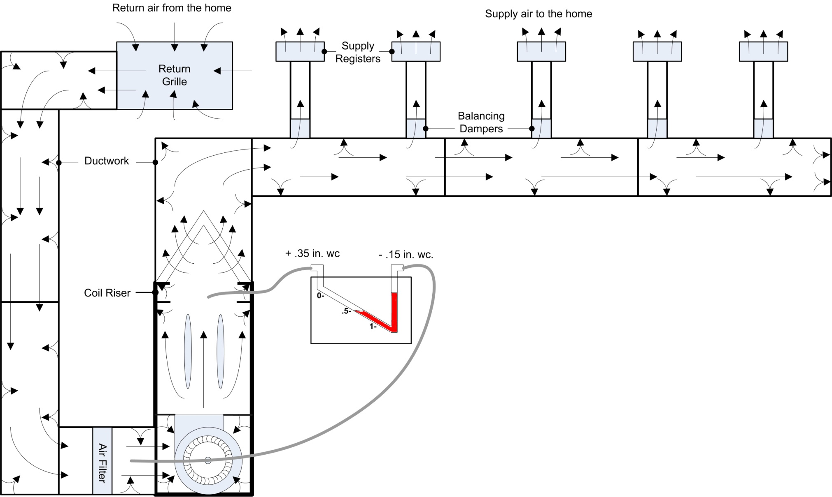
What is TESP?
Resistance to airflow
All components external to unit
Indoor Coil
Filter
Ductwork
Balancing Dampers
Registers/Grilles
Notes:
Air Handler and Package systems typically include all airside components except filter as specified by OEM. This leaves ductwork, dampers, registers and grilles as main areas of concern for TESP. However, dirt load on the components in these units will still affect airflow.

Slide 26
TESP Guidelines
Fossil Fuel
Try to operate around 0.5 in. wc. for best performance and noise
Try not to operate above 0.8 – 1.0
Air Handlers/Packs
Try to operate around 0.3 – 0.5 in. wc. for best performance and noise
Try not to operate above 0.8
Always follow OEM specifications if they are available. Most manufacturers will provide the recommended TESP that the system was rated at and the maximum it will perform at.

Slide 27
How Does TESP Effect Blowers
That depends on the type of blower motor
PSC Induction Motor
Constant Torque ECM
Airflow based on speed or tap selection at a given Total External Static Pressure (TESP)
Airflow changes with TESP
Constant Airflow ECM (Variable Speed)
Airflow is based on system configuration using dip switches
Airflow is maintained within recommended TESP range
Above recommended maximum TESP, airflow will decrease

Slide 28
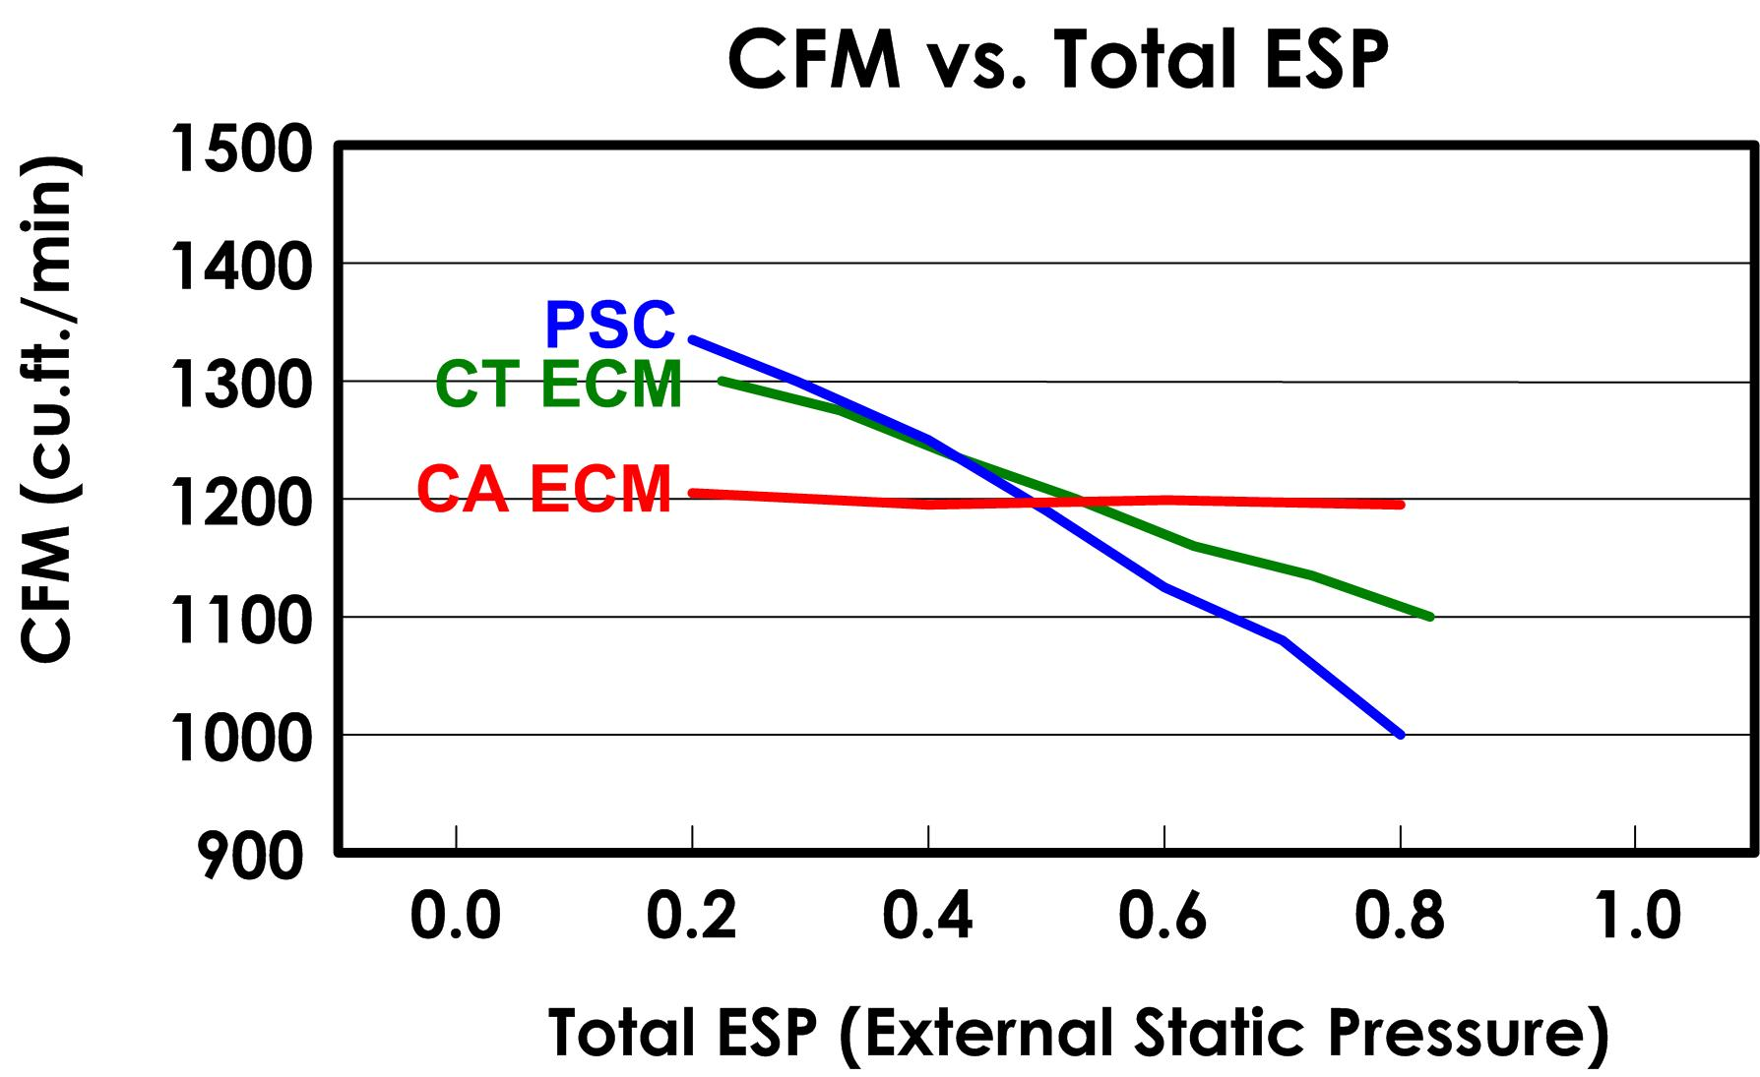
Understanding Blower Performance

Slide 29
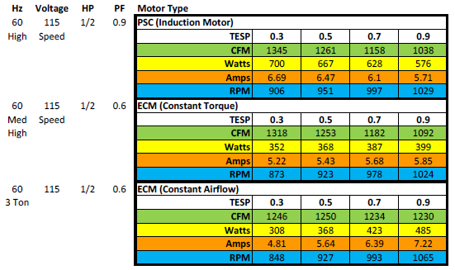
Understanding Blower Performance
Data is from lab testing on one particular unit. Numbers may vary from one unit to another.

Slide 30
The Nitty Gritty!
What have we not discussed yet?
Dirt load on airside components
How will this effect TESP?
How will this effect airflow?

Slide 31
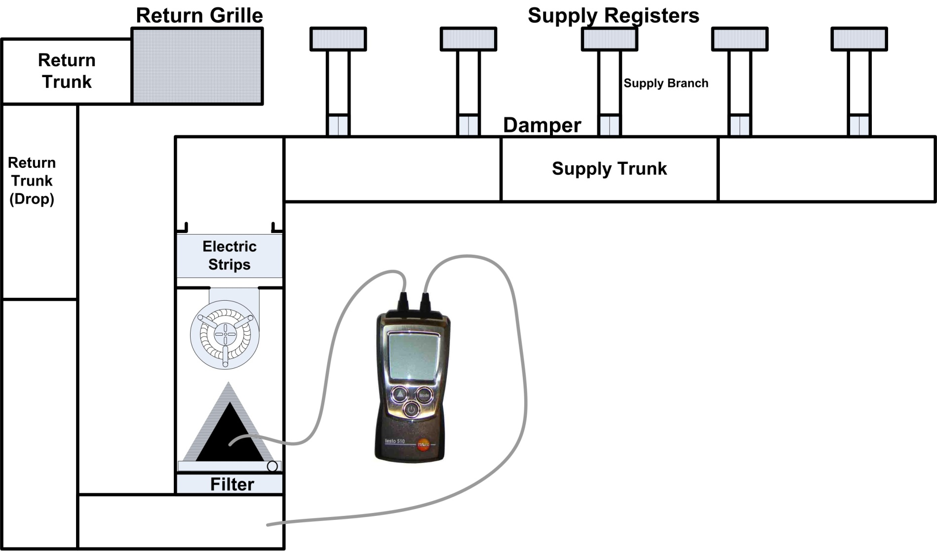
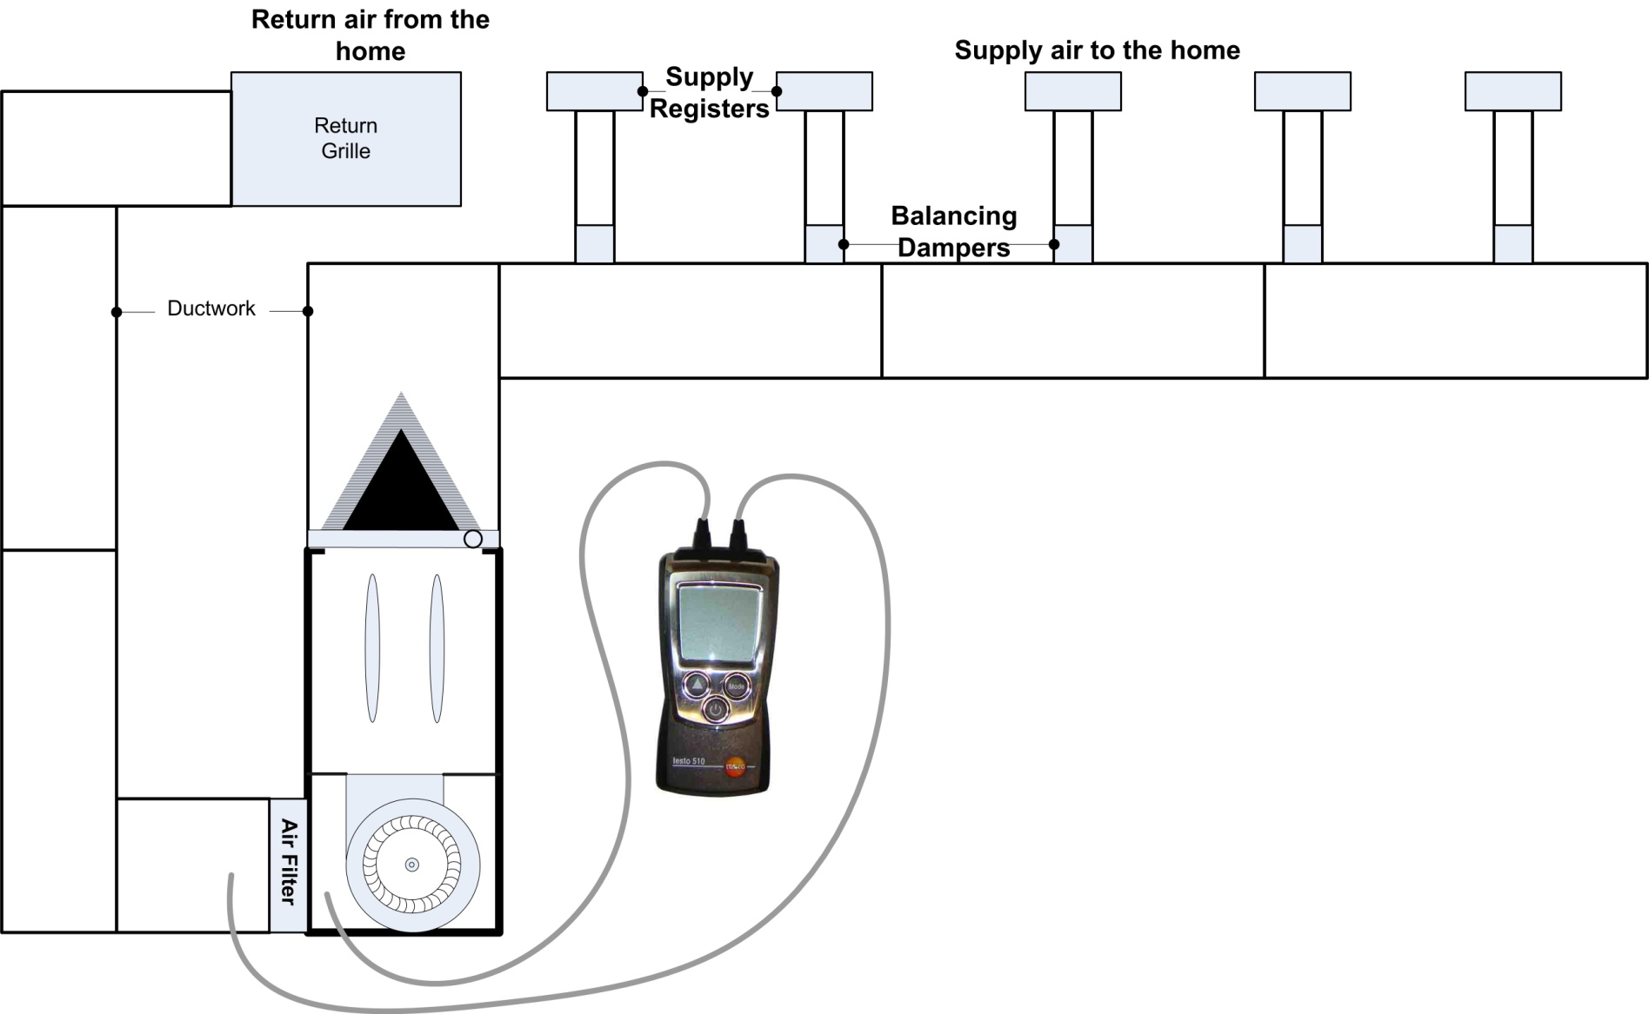
Air Filters
What is the Pressure Drop?
Measure across filter
Measure TESP with and without filter

Slide 32
Air Filters
What is the Pressure Drop?
0.10 – 0.20 in. wc.
How much airflow does it need to move?
This could be a big part of the problem
This could be the least expensive solution for the customer
Higher MERV may have higher resistance depending on filter size and airflow
Notes:
MERV (Minimum Efficiency Reporting Value)
Value of size particle filter can trap
OEM typically MERV 4

Slide 33
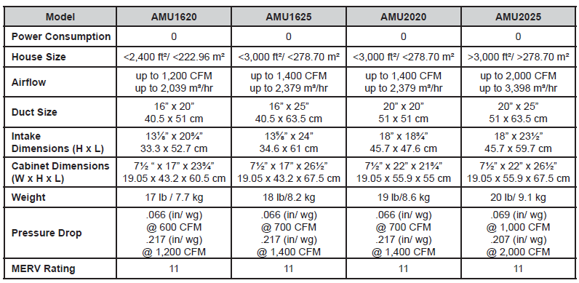
Air Filters
Deep Pleated media and electronic filters need to be sized properly as well.
SS-AMUr10 p2
Notes:
27 5/8 x 29 5/8

Slide 34
How to apply this information
Keep air side components clean
Measure airflow
Temperature Rise (Fossil Fuel Systems)
CFM (A/C and Heat Pump Systems)
Adjust blower operation for proper airflow
Measure TESP
Evaluate TESP concerns
Provide customer with airflow solutions
Communicate system operation and maintenance requirements to customers
Maintenance Programs !!!!!!!!

Slide 35
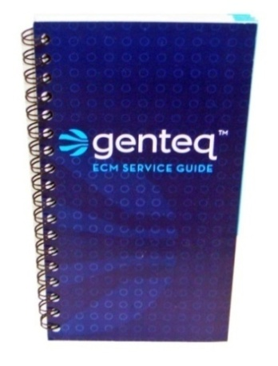
More Resources
Page 15
www.theDealerToolbox.com
Genteq product information & training videos
ECM Service Guide
Free to download
Troubleshooting Guide for all Genteq ECM
Constant Airflow (Variable Speed) indoor blower motors
Including use of TECMate
Constant Torque X13 and Evergreen indoor blower motors
Constant Speed 142 and 142^{R} outdoor fan motors

Slide 36
Thank YOU
would like to thank you for your dedication to professionalism and continuing education.

Slide 37
Hey “Paul & Kam”, don’t forget to answer questions, you do have a tendency to ramble you know.

Slide 38
That’s All Folks!

Slide 40
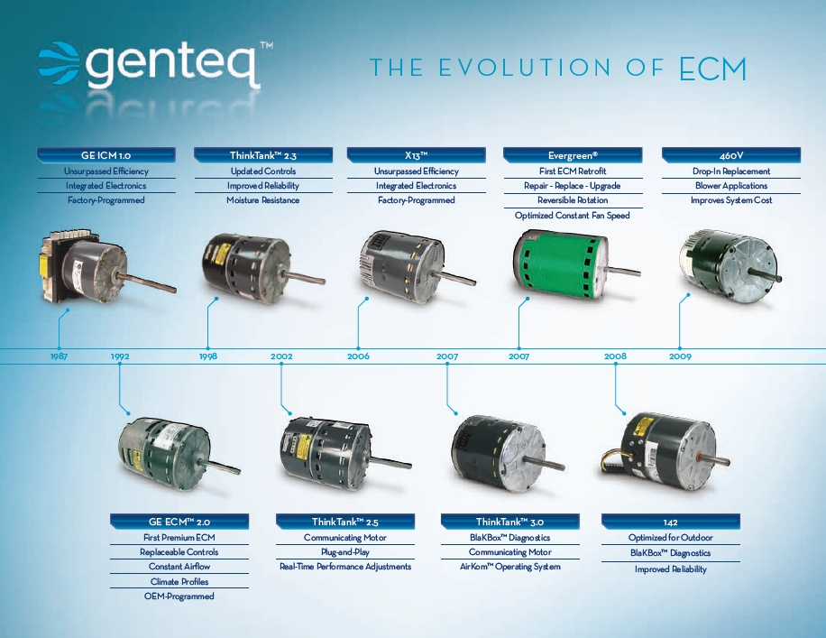
Page 7

Slide 41
Overview of ECM Technology
Page 8
Benefit of Technology
Electrical Efficiency
Program more precise and controlled operation
Wider range of operation
Enhance consumer comfort
Dehumidification
Constant Fan
Soft Start/Stop
Improved Airflow
Permanent magnet rotor
Motor
Control

Slide 42
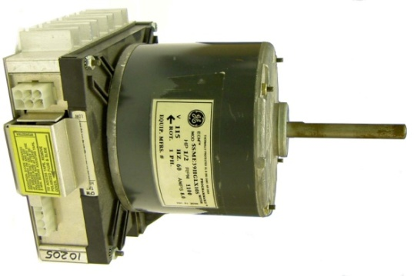
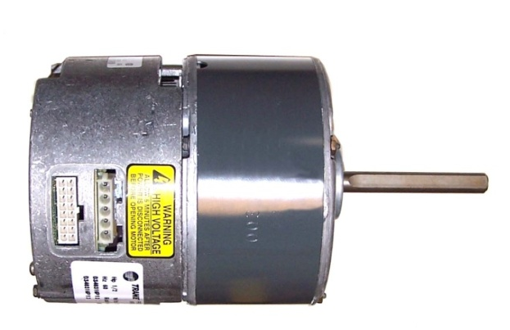
Constant Airflow ECM
Page 1
1987 ECM 1.0 First Variable Speed ECM
Basic Constant Airflow Algorithm
Often called the ICM-1 (Integrated Control Module)
No longer in production
1992 ECM 2.0 Complete Motor and Control Design
Refined Airflow Regulation Algorithm
“Motor is the airflow sensor”
First Speed Limited Programming
Often called the ICM-2 (Integrated Control Module)
No longer in production
Notes:
Those that think of this as new technology may be surprised to know that they have been around for almost 20 years.

Slide 43
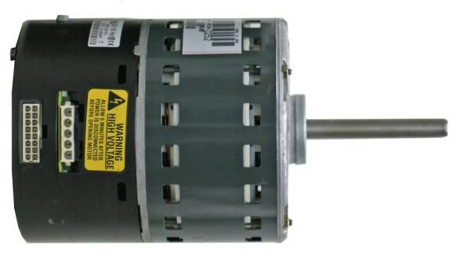
Constant Airflow ECM
Page 1
1998 ECM 2.3 Response to reliability improvement
Control Electronics and packaging redesign
Electronics encapsulated for moisture resistance
Improved performance and features
Sometimes called the ICM-2+
Currently in Production
2002 ECM 2.5 First Digital Serial Communication (DSI)
Enables plug & play HVAC systems
Fewer replacement part numbers
More accurate operation and fault reporting
No Longer In Production (As of 2009)
Notes:
Carrier (Infinity Systems) & Bryant (Evolution Systems) are the only HVAC OEM that used the ECM model 2.5 motor.

Slide 44


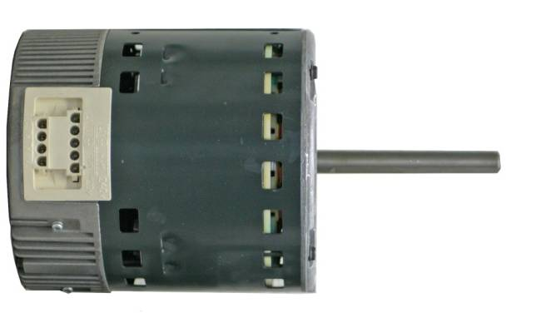
Constant Airflow ECM
Page 1
1998 ECM 2.3 Response to reliability improvement
Control Electronics and packaging redesign
Electronics encapsulated for moisture resistance
Improved performance and features
Sometimes called the ICM-2+
Currently in Production
Proven.
2007 ECM 3.0 Digital Serial Communication (DSI)
Enables plug & play HVAC systems
Fewer replacement part numbers
More accurate operation and fault reporting
Increased Resistance to power surges
BlakBox diagnostics
Increased moisture protection
- Single board design is fully potted
Currently In Production

Slide 45

Constant Torque ECM
Page 3
Operation
Taps have programmed torque values, not speeds
HVAC OEM can program taps in any order
Each tap has a unique torque value for its intended purpose
All taps may not be programmed
All X13 motors will physically have 5 taps
Supports multiple tap inputs

Slide 46
Constant Torque ECM
Page 3
Operation
Example OEM programming options
Notes:
If you have access to OEM manuals specific to your class participants needs, their charts can be inserted in this section to make the presentation product specific.

Slide 47
Constant Torque ECM
Page 5
Installation/Set-up
HVAC OEM manuals required for tap selection per demand
Taps are only programmed if needed
System wiring diagram will show tap usage
Notes:
If you have access to OEM manuals specific to your class participants needs, their charts can be inserted in this section to make the presentation product specific.

Slide 48
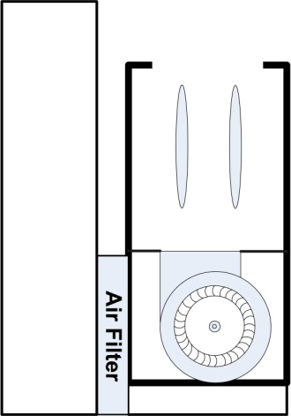
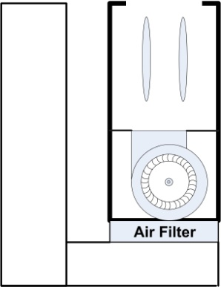
Air Filters
OEM guidelines
Proper unit cut-out
No returns through back
Over 1600 CFM may require two entrances
Over 1600 CFM may require two filters or special size
Where will the right size filter fit?

Slide 49


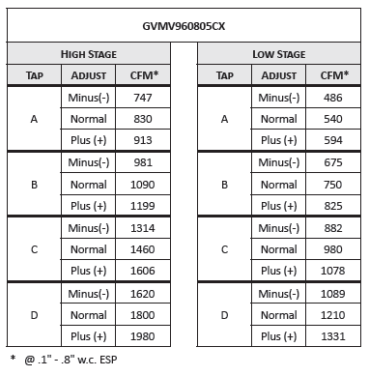
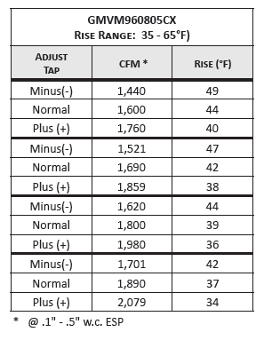
Blower Performance Data Constant Airflow (Variable Speed) ECM
Notes:
What if TESP is higher than these charts????

Slide 50
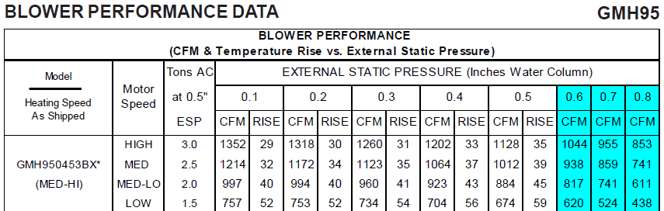
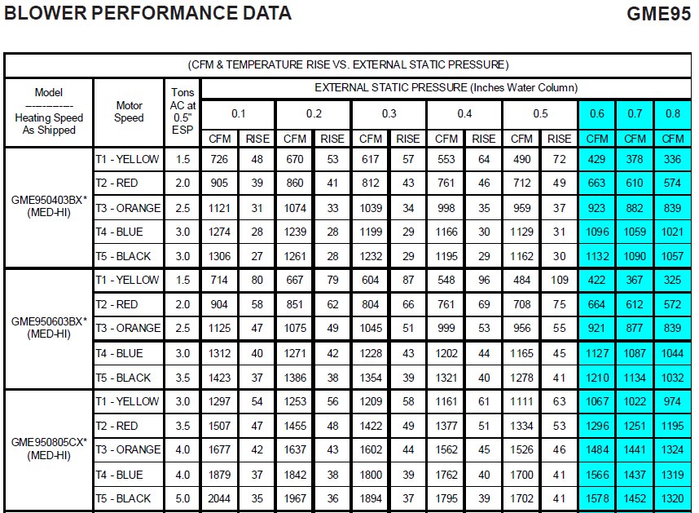
Blower Performance Data PSC & Constant Torque ECM
PSC Motor
Constant Torque ECM Motor

Slide 51
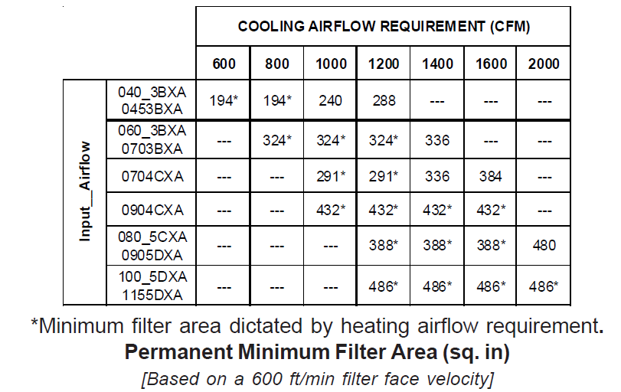
Air Filters
OEM 1” Filters = 600 FPM
High Velocity
Easy to size properly
Poor filtration
Low pressure drop, good for TESP
GMH95-IO2990-p33
x 600 = 1200 (288 = 14 x 20 or larger)
x 600 = 1350 (324 = 14 x 23 or larger)
x 600 = 1212 (291 = 14 x 20 or larger)
x 600 = 1800 (432 = 14 x 30or 20 x 22 or larger)
C = V x A
C = CFM
V = Velocity (Feet Per Minute) FPM
A = Area in Square Feet (H” x W” /144)

Slide 52
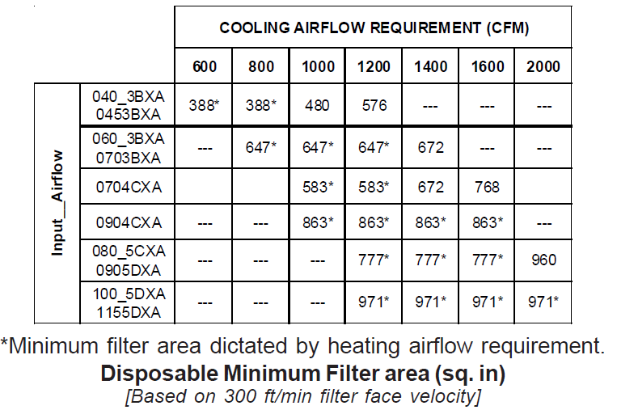
Air Filters
Most aftermarket 1” Filters = 300 FPM
Pleated media, electrostatic, electronic
Difficult to size properly
Better filtration
Under sizing increases pressure drop, Bad for TESP
GMH95-IO2990-p33
x 300 = 1200 (576 = 25 x 23 or larger)
x 300 = 1348 (647 = 25 x 26 or larger)
x 300 = 1213 (583 = 25 x 23 or larger)
x 300 = 1798 (863 = 25 x 35 or larger)
C = V x A
C = CFM
V = Velocity (Feet Per Minute) FPM
A = Area in Square Feet (H” x W” /144)

Slide 53
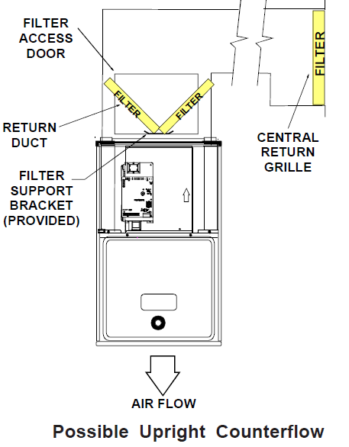
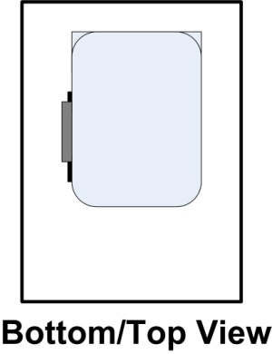
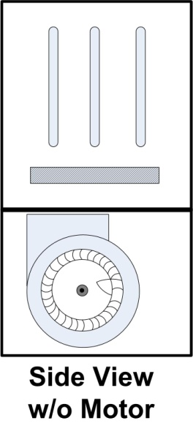
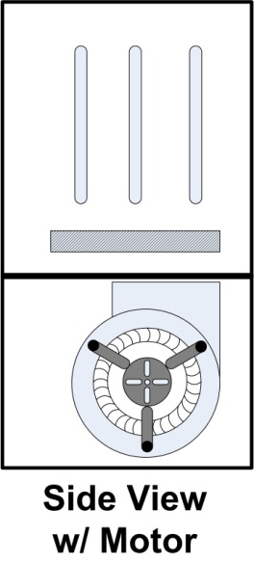
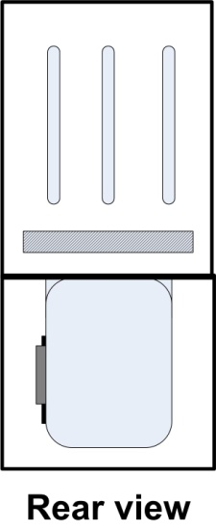
Air Filters
Registers & Grilles
Balancing Dampers
Filter size and load
Blower Wheel and Heat Exchanger load
Duct sizing and/or restriction
Why does the bottom require a larger filter than the side?
GMH95-IO2990-p33

